Slide 1

AI-ASSISTED ADAPTIVE DIFFUSION FOR LOW-LATENCY
AND SUSTAINABLE CHANNEL ESTIMATION
Course Code : BECE309L-D2+TD2
Course Title : Artificial Intelligence and Machine Learning
Dr. PRAVEEN JARAUT
SENSE – ECE
April 2026
2025-26 Winter Semester
Review 3- DA 3
Group 9
NITHUJAA J 23BEC1354
GOPIKA A 23BEC1357
DHANYA S 23BEC1432
Unveiling the Channel estimation Framework...

Slide 2
Agenda
Objective
Sustainable development goals
Problem Statement
Block diagram
Methodology
Inputs and Outputs
Software Requirements
Future Scope and Conclusion
Literature review
References

Slide 3
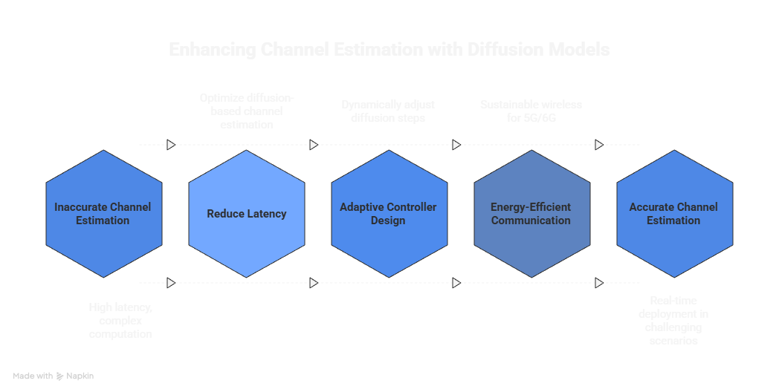
Objectives

Slide 4

Sustainable Development Goals

Slide 5

Problem Statement
Addressing Practical Limitations in Diffusion-Based Channel Estimation
Inefficiency of Fixed Diffusion Steps :
Existing diffusion-based channel estimation methods use a fixed number of denoising steps for all channel conditions, regardless of signal quality or mobility.
This results in unnecessary computation and latency, especially in high-SNR or slowly varying channels where fewer refinement steps are sufficient.
Lack of Adaptability to Channel Conditions:
Wireless channels vary significantly with SNR, mobility, and pilot density, but current models fail to adapt their denoising depth accordingly.
Applying the same diffusion process to both easy and difficult channel conditions leads to sub-optimal resource utilization.

Slide 6
Problem Statement
Addressing Practical Limitations in Diffusion-Based Channel Estimation
Gap Between Accuracy and Real-Time Feasibility:
While diffusion-based estimators achieve high accuracy, their fixed and computationally heavy inference process limits real-time deployment.
There is a need for adaptive solutions that balance estimation accuracy with latency and computational efficiency in practical systems.

Slide 7
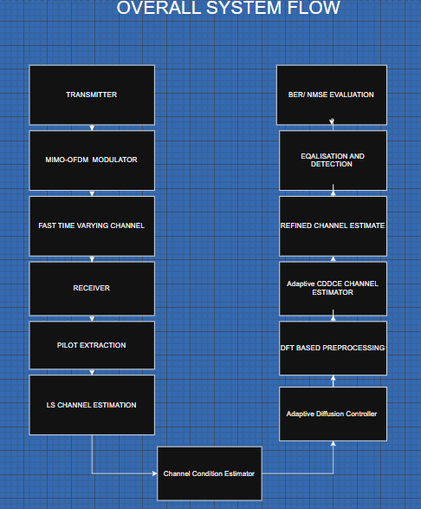
Block Diagram
OVERALL SYSTEM FLOW

Slide 8
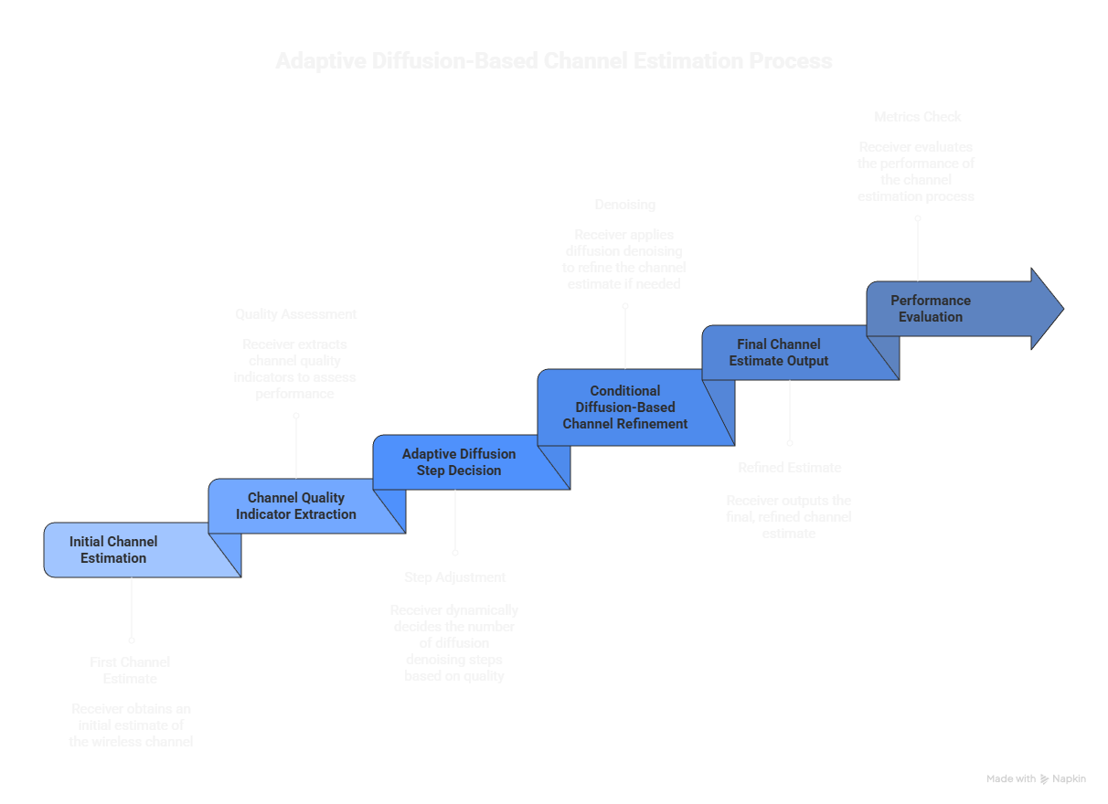
Methodology

Slide 9
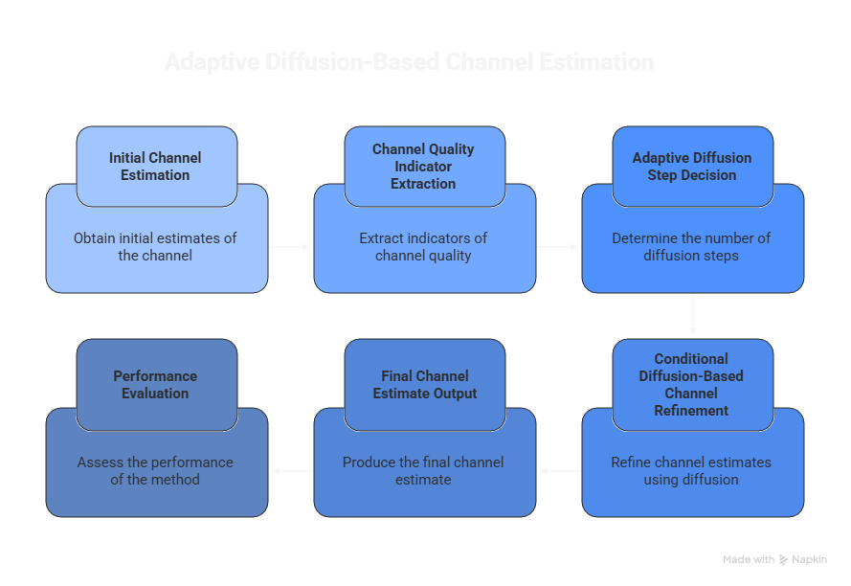
Methodology

Slide 10
Input to the System
Transmitted data symbols
Modulated using QPSK
Mapped onto OFDM subcarriers
Pilot symbols
Known symbols inserted at specific subcarriers
Used for initial (rough) channel estimation
MIMO-OFDM system parameters
Number of subcarriers
Number of transmit and receive antennas
OFDM symbol duration

Slide 11
Input to the System
Wireless channel characteristics
Multipath fading channel (3GPP TDL models: TDLA, TDLB, TDLC)
Fast time-varying conditions (high mobility)
Noise and distortions
Additive White Gaussian Noise (AWGN)
Optional clipping noise
Cyclic Prefix (CP) present or removed
Conditional information
Rough channel estimate obtained from pilots
Used as auxiliary input to the CDDCE model
Adaptive Diffusion Control Input
Channel quality indicators fed into:
A rule-based logic or
A lightweight prediction module
Output determines:
Required number of diffusion denoising steps.
Or an early-stopping signal during denoising

Slide 12
Expected Results
Accurate channel estimation
Refined Channel State Information (CSI)
Better estimation than LS, LS-DFT, and LMMSE methods
Improved NMSE performance
Lower NMSE across all SNR values
No early saturation at high SNR
Enhanced BER performance
Reduced bit error rate during signal detection
Stable performance even at high mobility
High robustness under adverse conditions
Maintains good performance when:
Cyclic Prefix (CP) is removed
Clipping noise is present
Pilot symbols are limited
Training and testing channels are mismatched
Better generalization capability
Works reliably across different channel models
Effective in fast-fading MIMO-OFDM environments

Slide 13
Software Requirements
MATLAB
Used for complete system modeling, including MIMO-OFDM modulation, pilot insertion, fast time-varying channel simulation, LS channel estimation, DFT-based preprocessing, CDDCE implementation, and performance evaluation.
1
MATLAB Communication Toolbox
Provides built-in functions for OFDM modulation/demodulation, MIMO processing, channel modeling, and BER computation.
2
MATLAB Signal Processing Toolbox
Used for DFT/IDFT operations, time-domain truncation, filtering, and signal denoising operations.
3
Deep Learning Toolbox
Required if the CDDCE model is implemented or trained using diffusion-based or learning-assisted denoising techniques.
4

Slide 14
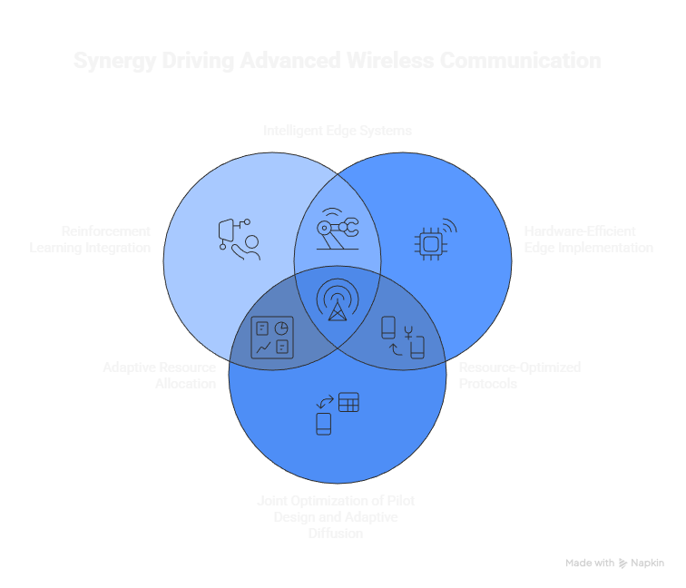
Future Scope

Slide 15
Conclusions
Diffusion-based channel estimation offers high accuracy but suffers from high latency
Fixed diffusion steps are inefficient for real-time wireless systems
Proposed AI-assisted adaptive diffusion framework dynamically controls inference steps
Achieves a balance between accuracy, latency, and energy efficiency
Supports sustainable, low-latency communication for future 5G and 6G networks

Slide 16
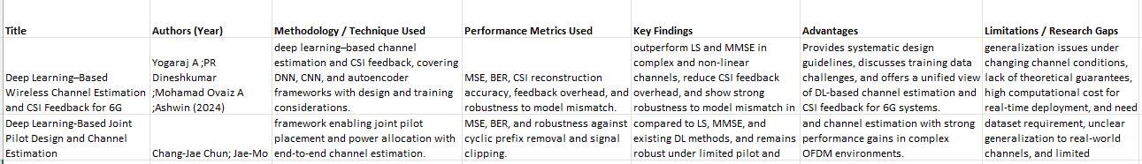
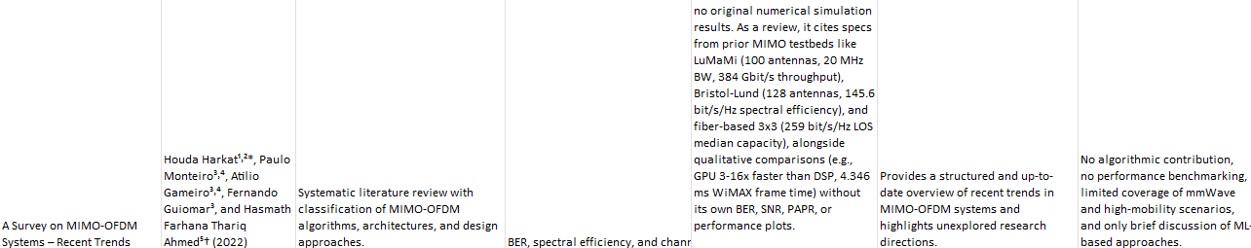
Literature Review

Slide 17
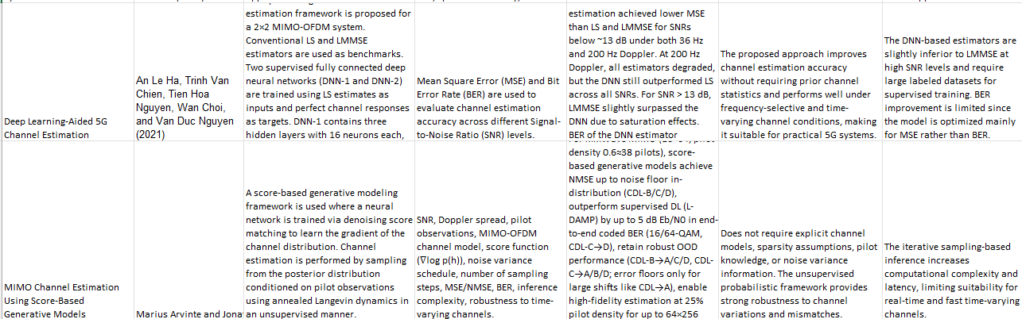
Literature Review

Slide 18
References
[1] H. Harkat, P. Monteiro, A. Gameiro, F. Guiomar, H. Farhana Thariq Ahmed, A survey on MIMO-OFDM systems: review of recent trends, Signals 3 (2) (2022) 359–395.
[2] H. Fu, W. Si, I.M. Kim, Deep learning-based joint pilot design and channel estimation for OFDM systems, IEEE Trans. Commun. 71 (8) (2023) 4577–4590.
[3]M. Arvinte, J.I. Tamir, MIMO channel estimation using score-based generative models, IEEE Trans. Wirel. Commun. 22 (6) (2022) 3698–3713..
[4]A. Le Ha, T. Van Chien, T.H. Nguyen, W. Choi, Deep learning-aided 5G channel estimation, in: Proc. 15th Int. Conf. Ubiquitous Inf. Manage. Commun. (IMCOM), 2021, pp. 1–7.
[5]W. Kim, Y. Ahn, J. Kim, B. Shim, Towards deep learning-aided wireless channel estimation and channel state information feedback for 6G, IEEE J. Commun. Netw. 25 (1) (2023) 61–75.
[6] Y. Song, S. Ermon, Generative modeling by estimating gradients of the data distri bution, in: Proc. Adv. Neural Inf. Process. Syst. (NeurIPS), vol. 32, 2019.

Slide 19
Implementation Progress
The proposed framework was implemented using Python and PyTorch.
The following modules were developed:
• MIMO-OFDM signal generation
• 3GPP TDL-C channel modeling
• LS based initial channel estimation
• Diffusion based channel denoising model
• Adaptive diffusion control mechanism
• Performance evaluation using NMSE and BER
The complete system is implemented as an end-to-end simulation framework.

Slide 20
A-CDDCE System Architecture
MIMO-OFDM transmitter generates QPSK symbols
Signals pass through 3GPP TDL-C fading channel
Pilot symbols enable LS channel estimation
LS estimate is used as conditional input to diffusion model
Diffusion model performs iterative denoising
Adaptive mechanism selects number of diffusion steps
Final refined channel estimate is obtained
Output: Accurate Channel State Information (CSI)

Slide 21
Wireless Channel Model
The system uses 3GPP TDL-C multipath channel model.
Key characteristics:
• Multipath fading with delay spread
• High mobility scenario (120 km/h)
• Frequency selective fading
• Time varying channel conditions
System parameters:
Subcarriers = 64
MIMO configuration = 2 × 2
OFDM frames = 32
Channel taps used = 28
This provides realistic 5G channel simulation conditions.

Slide 22
Conditional Diffusion Channel Estimation
The diffusion model learns to remove noise from rough channel estimates.
Process:
True channel representation is gradually corrupted with noise
Neural network learns to predict the noise
Reverse diffusion process removes noise step-by-step
Final output produces refined channel estimate
Advantages:
• Handles nonlinear channel distortions
• Robust to noise
• Works with limited pilot symbols

Slide 23
Adaptive Diffusion Step Selection
Traditional diffusion models use fixed denoising steps.
Problem:
• High latency
• Unnecessary computation at high SNR
Our solution:
Adaptive diffusion depth based on Channel Quality Indicator (CQI)
Mechanism:
CQI extracted from LS channel estimate
Rule-based controller selects diffusion steps
High SNR → fewer steps
Low SNR → more steps
Result:
Reduced latency while maintaining accuracy.

Slide 24
Improved U-Net Architecture
The denoising network is based on U-Net with enhancements.
Key features:
• Conditional SNR embedding
• Residual convolution blocks
• Dual-Axis Attention module
• Skip connections for feature preservation
Benefits:
• Better spatial-temporal feature extraction
• Improved channel reconstruction accuracy
• Faster convergence during training

Slide 25
Improved U-Net Architecture
The denoising network is based on U-Net with enhancements.
Key features:
• Conditional SNR embedding
• Residual convolution blocks
• Dual-Axis Attention module
• Skip connections for feature preservation
Benefits:
• Better spatial-temporal feature extraction
• Improved channel reconstruction accuracy
• Faster convergence during training

Slide 26
Dual-Axis Attention Mechanism
Two attention modules are applied:
Frequency-axis attention
Learns correlation across subcarriers
Time-axis attention
Learns correlation across OFDM frames
Advantages:
• Captures channel variation in both dimensions
• Improves estimation for fast-fading channels
• Enhances model robustness

Slide 27
Monte-Carlo Dropout Inference
To improve reliability, multiple stochastic forward passes are performed.
Steps:
Enable dropout during inference
Run diffusion model multiple times
Average predictions
Benefits:
• Reduces estimation variance
• Improves stability of CSI prediction
• Provides more reliable channel estimation

Slide 28
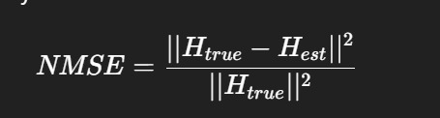
Evaluation Metrics
Two key metrics are used:
1. NMSE (Normalized Mean Square Error)
Measures channel estimation accuracy
Lower NMSE → better estimation.
2. BER (Bit Error Rate)
Measures symbol detection performance.
Lower BER indicates more reliable communication.

Slide 29
Channel Estimation Methods Compared
The following estimators are evaluated:
• LS (Least Squares) – baseline method
• CDDCE – fixed diffusion channel estimator
• A-CDDCE – proposed adaptive diffusion estimator
Objective:
Show that A-CDDCE improves NMSE and BER performance.
Expected outcomes:
• Lower NMSE across all SNR values
• Improved BER performance
• Reduced inference latency
• Better adaptation to varying channel conditions
The adaptive mechanism ensures:
Higher efficiency for practical 5G/6G systems.

Slide 30
The proposed A-CDDCE framework introduces adaptive control in diffusion-based channel estimation.
Key contributions:
• Adaptive diffusion step selection
• Dual-Axis attention architecture
• Monte-Carlo dropout inference
The approach improves accuracy, robustness, and computational efficiency for next-generation wireless systems.

Slide 31
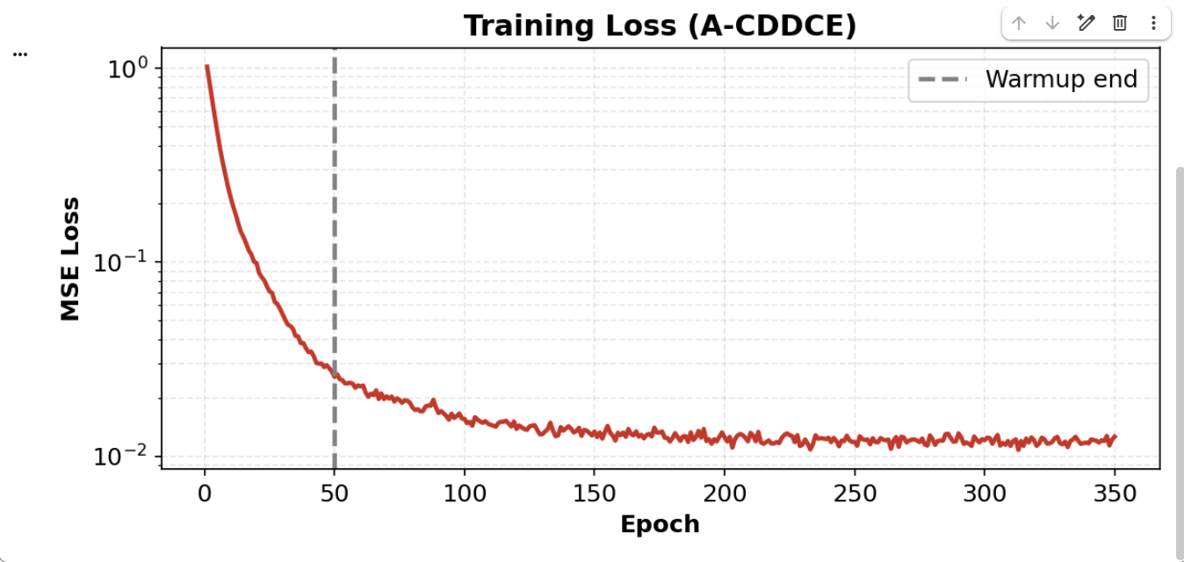
RESULTS -TRAINING LOSS F0R A-CDDCE METHOD

Slide 32
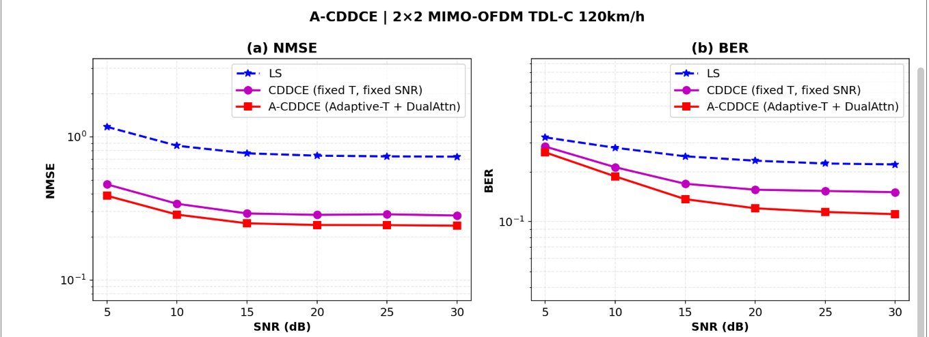
RESULTS-NMSE AND BER PLOTS FOR LS,CDDCE AND A-CDDCE METHODS

Slide 33
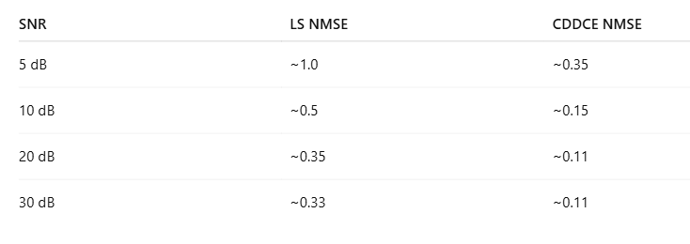
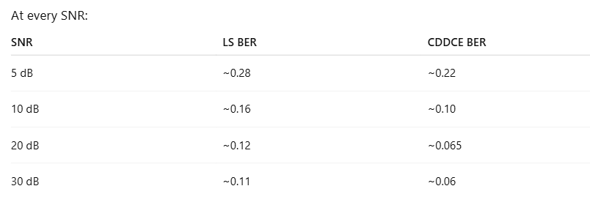
INFERENCE
The BER improvement confirms that NMSE gains are not only mathematical improvements but also practically beneficial for reliable communication.
Also,Even at high SNR:
LS ≈ 0.11 and CDDCE ≈ 0.06
That’s almost 2× improvement in BER.
CDDCE significantly suppresses noise but residual modeling limitations cause mild saturation at high SNR.
CDDCE provides 3–5× NMSE reduction compared to LS.

Slide 34
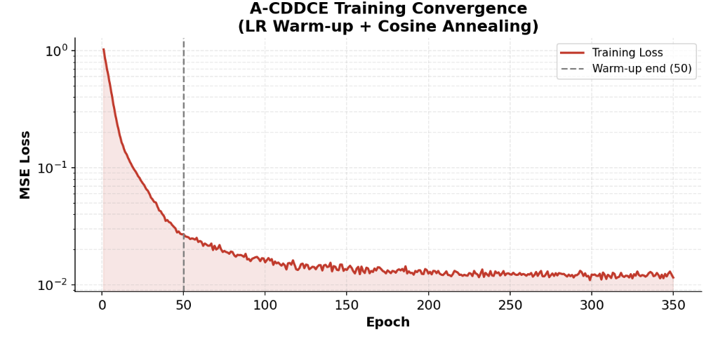
COMPARISON RESULTS FROM PREVIOUS PAPERS
MIMO-OFDM Channel Estimation using Pilot Carriers

Slide 35
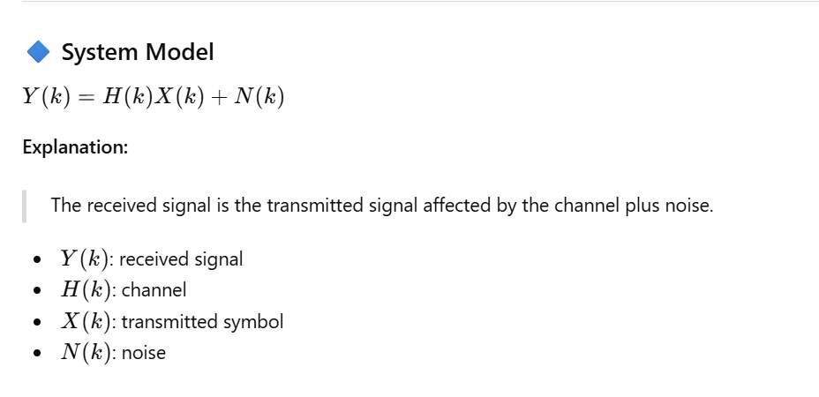
COMPARISON RESULTS FROM PREVIOUS PAPERS
MIMO-OFDM Channel Estimation using Pilot Carriers-Bagadi

Slide 36
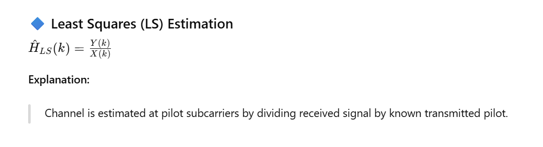
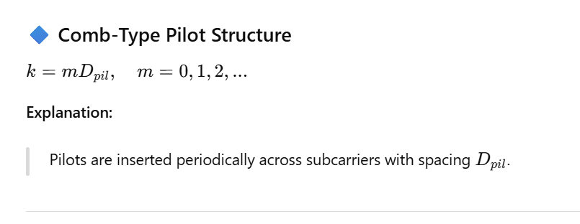
COMPARISON RESULTS FROM PREVIOUS PAPERS
MIMO-OFDM Channel Estimation using Pilot Carriers-Bagadi

Slide 37
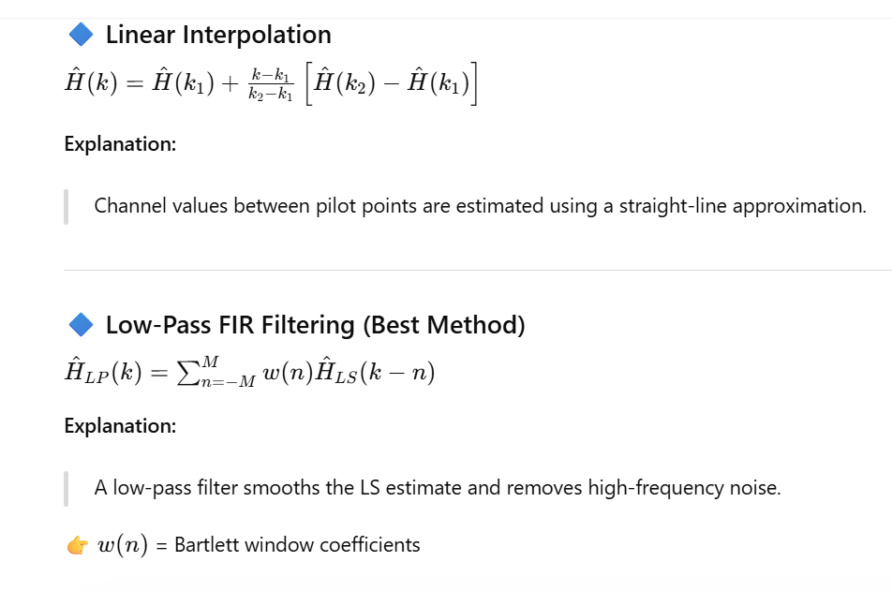
COMPARISON RESULTS FROM PREVIOUS PAPERS
MIMO-OFDM Channel Estimation using Pilot Carriers-Bagadi

Slide 38
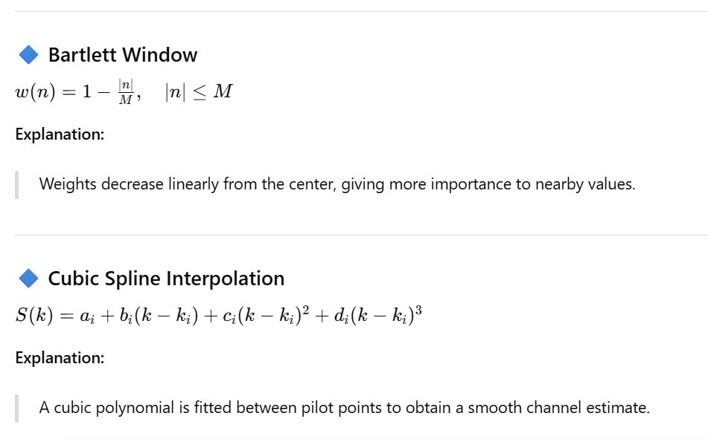
COMPARISON RESULTS FROM PREVIOUS PAPERS
MIMO-OFDM Channel Estimation using Pilot Carriers-Bagadi

Slide 39
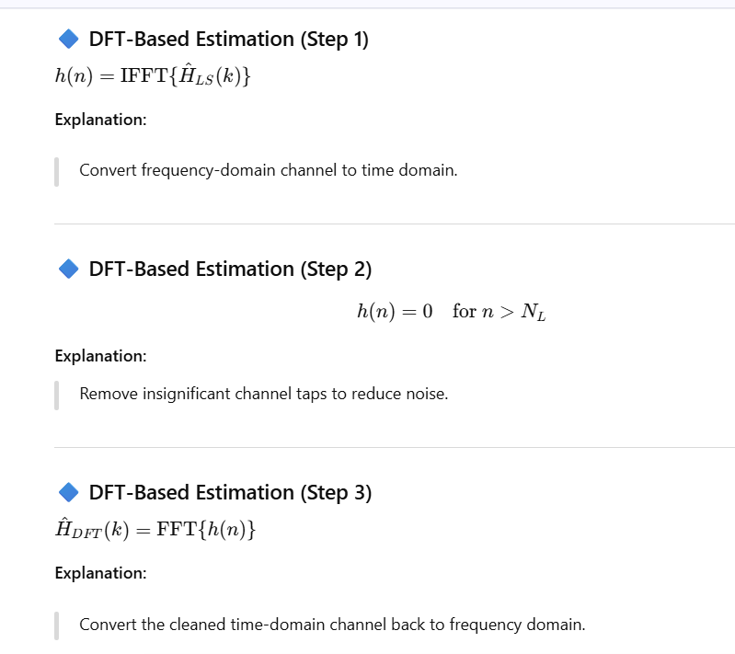
COMPARISON RESULTS FROM PREVIOUS PAPERS
MIMO-OFDM Channel Estimation using Pilot Carriers-Bagadi

Slide 40
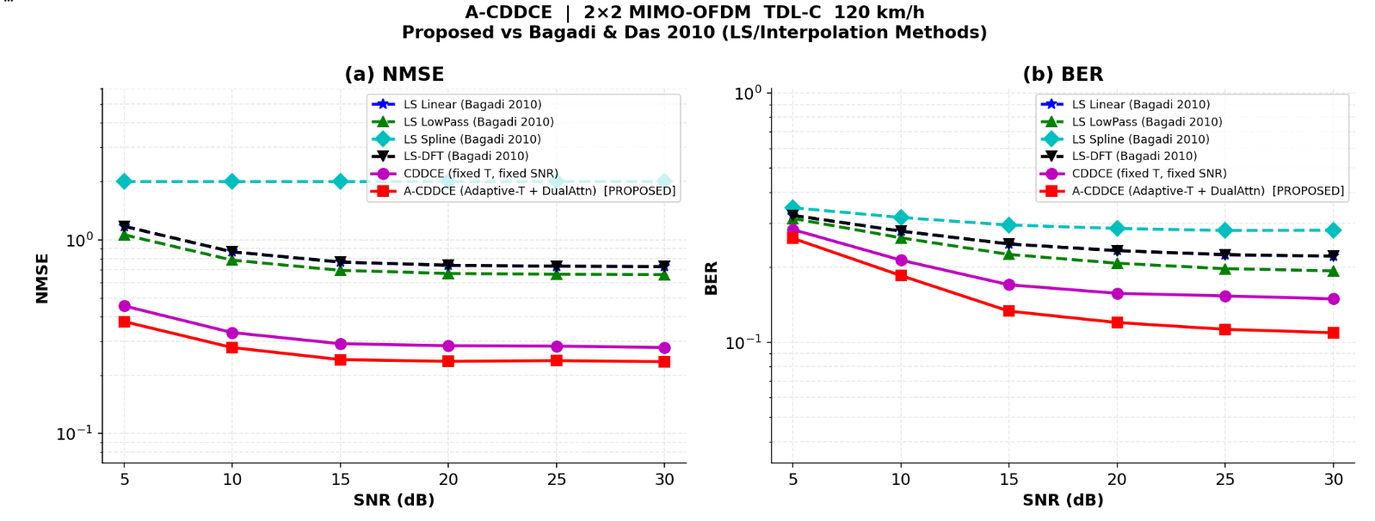
COMPARISON RESULTS FROM PREVIOUS PAPERS
MIMO-OFDM Channel Estimation using Pilot Carriers

Slide 41
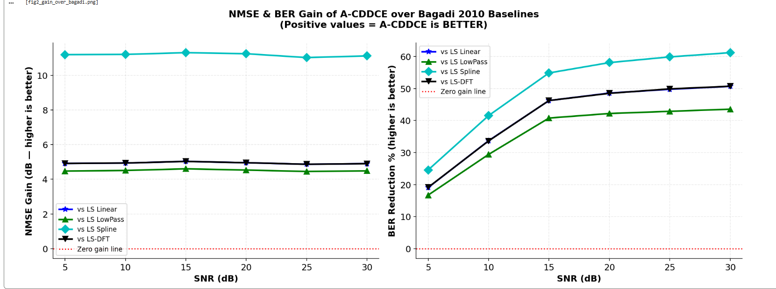
COMPARISON RESULTS FROM PREVIOUS PAPERS
MIMO-OFDM Channel Estimation using Pilot Carriers

Slide 42
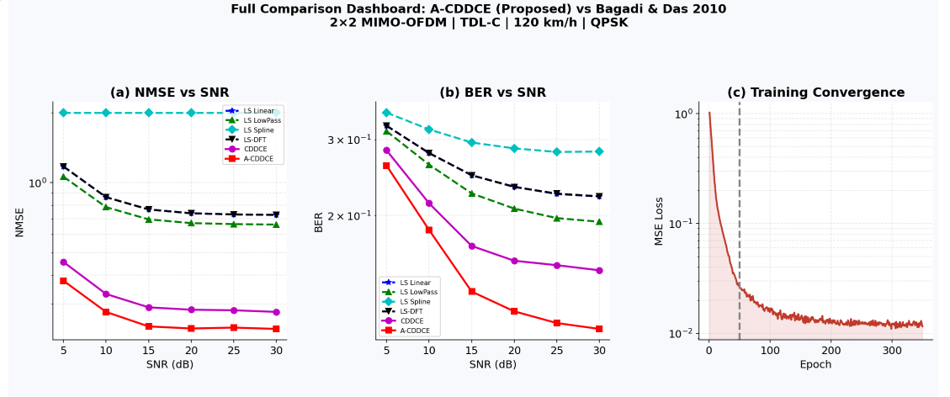
COMPARISON RESULTS FROM PREVIOUS PAPERS
MIMO-OFDM Channel Estimation using Pilot Carriers

Slide 43
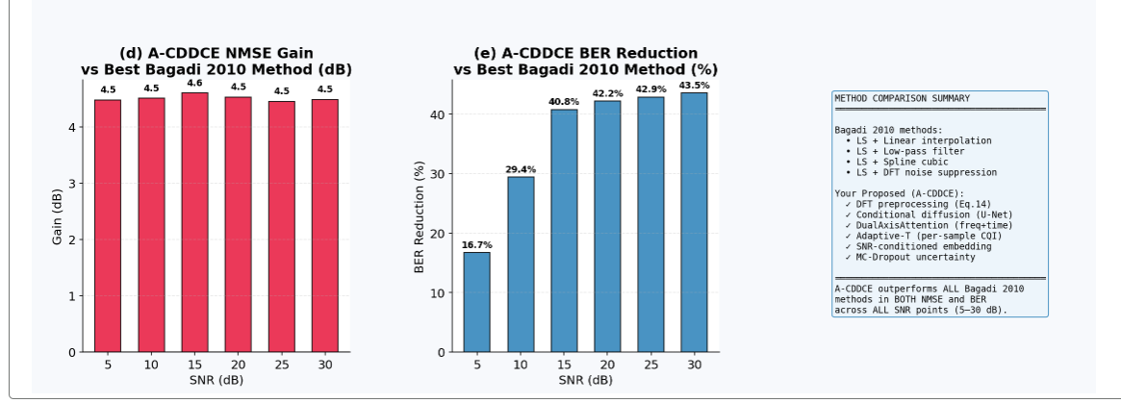
COMPARISON RESULTS FROM PREVIOUS PAPERS
MIMO-OFDM Channel Estimation using Pilot Carriers

Slide 44
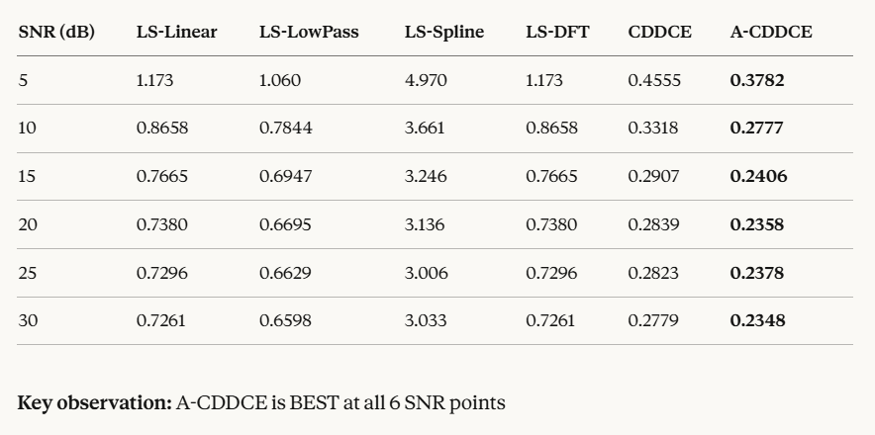
COMPARISON RESULTS FROM PREVIOUS PAPERS
NMSE COMPARISON

Slide 45
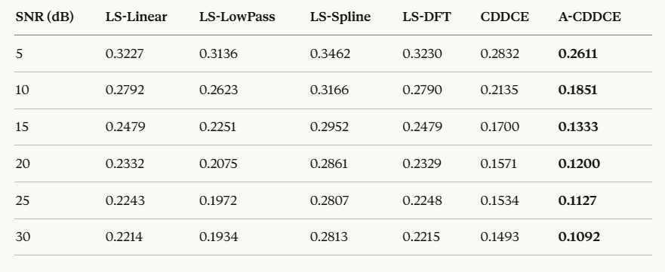
COMPARISON RESULTS FROM PREVIOUS PAPERS
BER COMPARISON

Slide 46
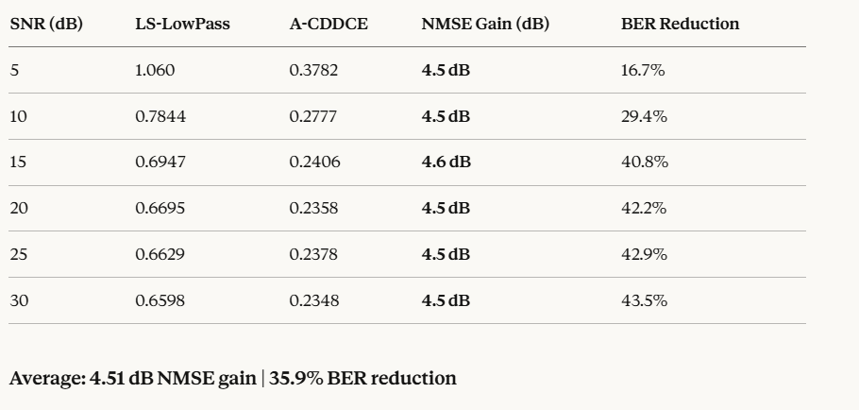
COMPARISON RESULTS FROM PREVIOUS PAPERS
A-CDDCE vs BAGADI

Slide 47
Bagadi 2010 — Why it loses:
LS estimator ignores noise statistics completely
Interpolation handles only pilot locations, not ICI between subcarriers
No learning of channel statistics from data
Rayleigh assumption breaks under TDL-C fast fading at 120 km/h
NMSE plateaus at high SNR (no noise floor reduction)
CDDCE — Why it partially wins but not fully:
Diffusion backbone learns channel distribution
But fixed T=7 steps wastes computation at high SNR
No attention means frequency-time correlations are missed
Single deterministic pass — no uncertainty handling
A-CDDCE — Why it wins:
Adaptive-T uses fewer steps at high SNR (efficient + accurate)
DualAxisAttention captures both frequency and time correlations jointly
MC-Dropout gives robust uncertainty-averaged estimate
SNR embedding adapts the model behavior per channel quality
DFT preprocessing removes noise before diffusion even starts

Slide 48
CONCLUSION
Among all methods, A-CDDCE performs the best in channel estimation accuracy
LS method shows the worst performance due to high sensitivity to noise and mismatch
CDDCE improves over LS, but uses fixed diffusion steps, limiting flexibility
A-CDDCE outperforms both by using adaptive diffusion steps based on SNR
PERFORMANCE ANALYSIS
NMSE: A-CDDCE < CDDCE <LS
BER: A-CDDCE < CDDCE < LS

